Slide 1
RETAIL STORE
DATA ANALYSIS
Presented by: Dipesh Yadav
Date: 3 July, 2025

Slide 2
CONTENT
Business Context
Business Problem
Technology Stack
Data Overview
Data Dictionary
Data Import Issues
ER-Diagram
Data Processing
Data Audit
Data Discrepancy
Descriptive Analysis
Diagnostic Analysis
Predictive Analysis
Prescriptive Analysis
Cognitive Analysis
Real-Time Analysis
Dashboards
Challenges & Learnings

Slide 3
BUISNESS CONTEXT
The business is a multi-channel retail operation with a presence across various states and regions in India.
It sells a diverse range of products, including Electronics, Home Appliances, Furniture, Baby products, and more.
Sales channels include In-store purchases, Phone Delivery, and an Online platform.
The business tracks customer information, order details, payments, and post-purchase customer satisfaction.

Slide 4
BUSINESS PROBLEM
Limited Customer Insights
Difficulty in segmenting customers, understanding purchasing behaviour, and improving satisfaction
Unoptimized Product Performance
Lack of clarity on best-selling products, slow-moving inventory, and cross-selling opportunities.
Inefficient Store & Channel Performance
Need to assess store-level sales, regional demand variations, and the impact of different sales channels.
Sales Growth Challenges
No clear strategy to increase revenue, optimize promotions, and enhance customer retention.

Slide 5
TECHNOLOGY STACK
Tool | Purpose in this Project
Microsoft Excel | Initial data review, quick data profiling, and handling of smaller lookup files (like the Stores data).
SQL (SQL Server) | The core of data processing. Used for data ingestion, performing robust data quality checks, cleaning inconsistencies, and joining the six disparate data sources into a master analysis table. All complex aggregations will be done here.
Power BI | Primary visualization and dashboarding tool. Used to connect to the SQL Server database to create interactive dashboards, visualize KPIs, and enable drill-down capabilities for descriptive and diagnostic analysis.
PowerPoint (PPT) | Final reporting and communication tool. Used to present the key findings, insights, and strategic recommendations to the client in a clear and structured narrative.

Slide 6
DATA OVERVIEW
Data timeframe: Sep 2021 - Oct 2023
Covers 39 randomly selected stores out of 535
Product Categories: Specific categories included
Customers: Randomly selected
Data is present in 6 different tables:
Customers
Orders
OrderPayments
StoresInfo
ProductsInfo
OrdersRating_Review

Slide 7
DATA DICTIONARY (1/4)
Orders
customer_id | Identifier linking order to a customer
order_id | Unique identifier for each order
product_id | Identifier linking order to a product
channel | Purchase channel (e.g., online, in-store)
delivered_storeId | Store responsible for order delivery
bill_date_timestamp | Timestamp of when the order was billed
quantity | Number of items in the order
cost_per_unit | Cost per unit of the product
MRP | Maximum Retail Price of the product
discount | Discount applied to the order
total_amount | Final amount after discount

Slide 8
DATA DICTIONARY (2/4)
ProductsInfo
product_id | Unique identifier for each product
category | Category of the product
product_name_length | Length of the product name
product_description_length | Length of the product description
product_photos_qty | Number of product photos available
product_weight_g | Weight of the product in grams
product_length_cm | Length of the product in cm
product_height_cm | Height of the product in cm
product_width_cm | Width of the product in cm

Slide 9
DATA DICTIONARY (3/4)
Customers
StoresInfo
custId | Unique identifier for each customer
customer_city | City where the customer resides
customer_state | State where the customer resides
gender | Gender of the customer i.e. 'M': Male, 'F': Female
storeId | Unique identifier for each store
seller_city | City where the store is located
seller_state | State where the store is located
region | Geographical region classification

Slide 10
DATA DICTIONARY (4/4)
OrderPayments
OrderRating_Review
order_id | Identifier linking payment to an order
payment_type | Payment method used
payment_value | Amount paid
order_id | Identifier linking review to an order
customer_satisfaction_ score | Rating given by the customer i.e. between 1-5

Slide 11
DATA IMPORT ISSUES
Issue | Reason
Data Type Mismatch | Some columns may contain mixed data types (e.g., numeric columns having text values). Example: A column meant for INT may have string values like "N/A" or "Unknown".
Incorrect Date Format | Different date formats (YYYY-MM-DD, MM/DD/YYYY) not match SQL Server's default format. Example: 01-12-2025 (Ambiguous: is it Jan 12 or Dec 1?)
Encoding Issues | If the CSV file is encoded in UTF-8 but SQL Server expects Latin-1, special characters may be garbled. Example: Customer names with accents (e.g., José, François) may not import correctly.
Duplicate Records | If no primary key constraints exist, duplicate rows may be inserted. Example: The StoreInfo table may contain multiple records with the same storeId.
Null and Blank Values | Missing data in CSV files may cause errors when inserting into NOT NULL columns. Example: Allow Null values where applicable.
Foreign Key Violations | If a referenced value doesn’t exist in the parent table, SQL Server will reject the insert. Example: An order_id in OrderPayments table doesn’t exist in Orders table.

Slide 12
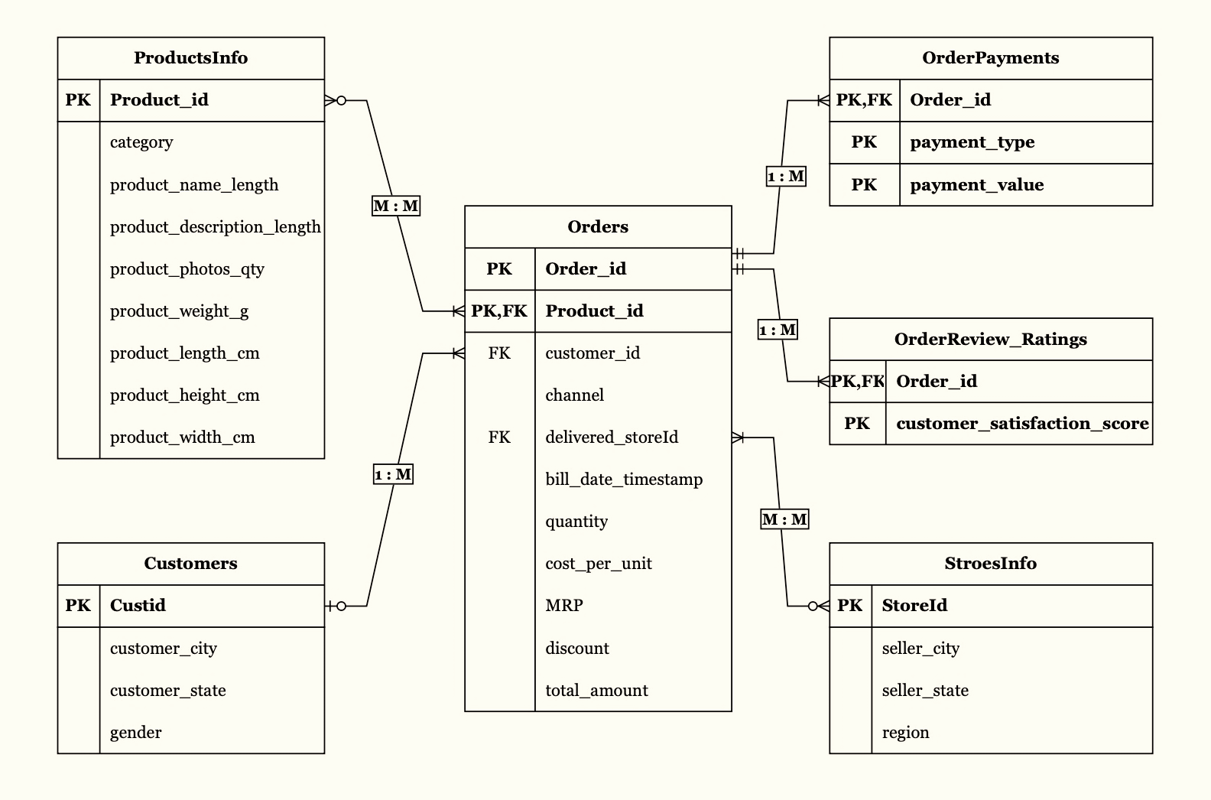
ER DIAGRAM

Slide 13
DATA PROCESSING (1/2)
Data Cleaning
Data Standardization
Task | Description
🧹 Remove Duplicates | Drop identical transaction rows
❌ Handle Nulls/Blanks | Fill missing values or remove rows
🔢 Fix Incorrect Data Types | Convert text → numeric, date, etc.
✂️ Trim Whitespaces | Remove leading/trailing spaces
🔄 Replace Erroneous Values | Correct invalid entries
💣 Remove Outliers | Identify using z-score or IQR
Task | Description
🏪 Standardize Text Values | Format category names, locations, etc.
📅 Normalize Date Format | Convert to consistent format
🎨 Format Currency Fields | Ensure decimals and symbols are consistent
📇 Encode Categories | Use consistent codes or names
🌐 Language Consistency | Translate or unify language if mixed

Slide 14
DATA PROCESSING (2/2)
Data Validation
Data Enrichment
Task | Description
🔁 Validate Ranges | Check numeric limits
🔍 Check Referential Integrity | Match IDs with master tables
🧾 Validate Totals | Total_Amount = (Price - Discount) * Quantity
🛒 Transaction Uniqueness | Ensure Transaction_ID is unique
🕒 Validate Date/Time | No future dates or invalid timestamps
Task | Description
🧠 Derive Discount % | Discount / Price * 100
📅 Extract Date Parts | Year, Month, Day, Weekday from Transaction_Date
🛍️ Calculate Basket Size | SUM(Quantity) per transaction
🧑‍💼 Segment Customers | RFM segmentation: Recency, Frequency, Monetary
🛍️ Product Margin | Selling Price - Cost Price

Slide 15
DATA AUDIT (1/3)
Customers
Orders
Number of attributes | 4
Total records | 99,441
Number of missing values | 0
Number of duplicate records | 0
Unique customer states | 20
Unique gender | 2 (i.e. ’M’: Male, and ‘F’: Female)
Customers with zero orders | 866
Number of attributes | 11
Total records | 112,650
Total unique orders | 98,666
Number of missing values | 0
Number of duplicate records | 10,225
Multiple products per order | Same order_id appears multiple times
Channel available | Instore, Online, & Phone delivery
Orders without payment details | 3
Wrong data type | Bill_date_timestamp

Slide 16
DATA AUDIT (2/3)
Stores Info
Products Info
Number of attributes | 4
Total records | 535
Number of missing values | 0
Number of duplicate records | 1 (ST410)
Unique store IDs | 534
Unique regions | North, South, East, West
Unique city | 534 (only 1 store in each city)
Stores with zero orders | 497
Number of attributes | 9
Total records | 32,951
Number of missing values | 2,461 (in multiple columns)
Key missing fields | Category – 623 missing Product dimensions – 2 missing Name length & description length – 610 missing
Number of duplicate records | 0
Unique product category present | 14 (one of them is #N/A)

Slide 17
DATA AUDIT (3/3)
Order Payment
Order Review Rating
Number of attributes | 3
Total records | 103,886
Number of missing values | 0
Number of duplicate records | 615
Multiple payment methods per order | Same order_id appears multiple times
Payment types available | Credit card, Debit card, UPI/ Cash, Voucher
Invalid records | 830 records have invalid order_id (not exist in Orders table)
Outliers | Payment value – 9 (orders with 0 amount )
Number of attributes | 2
Total records | 100,000
Number of missing values | 0
Unique orders | 99,441
Number of duplicate records | 350
Multiple reviews per order | Same order_id appears multiple times
Customer satisfaction score | 5 unique values (i.e. 1-5)
Invalid records | 778 records have invalid order_ids

Slide 18
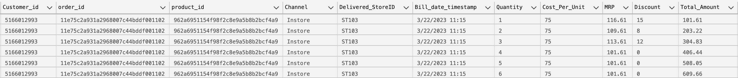
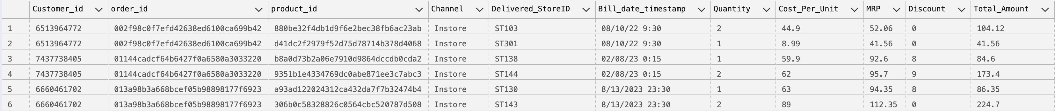
DATA DISCREPANCY (1/5)
IN ORDERS TABLE:
Quantity and Total Amount are cumulative.
MRP varies for the same Product ID.
The same order is delivered by different stores at the same time, despite the channel being In-Store.

Slide 19

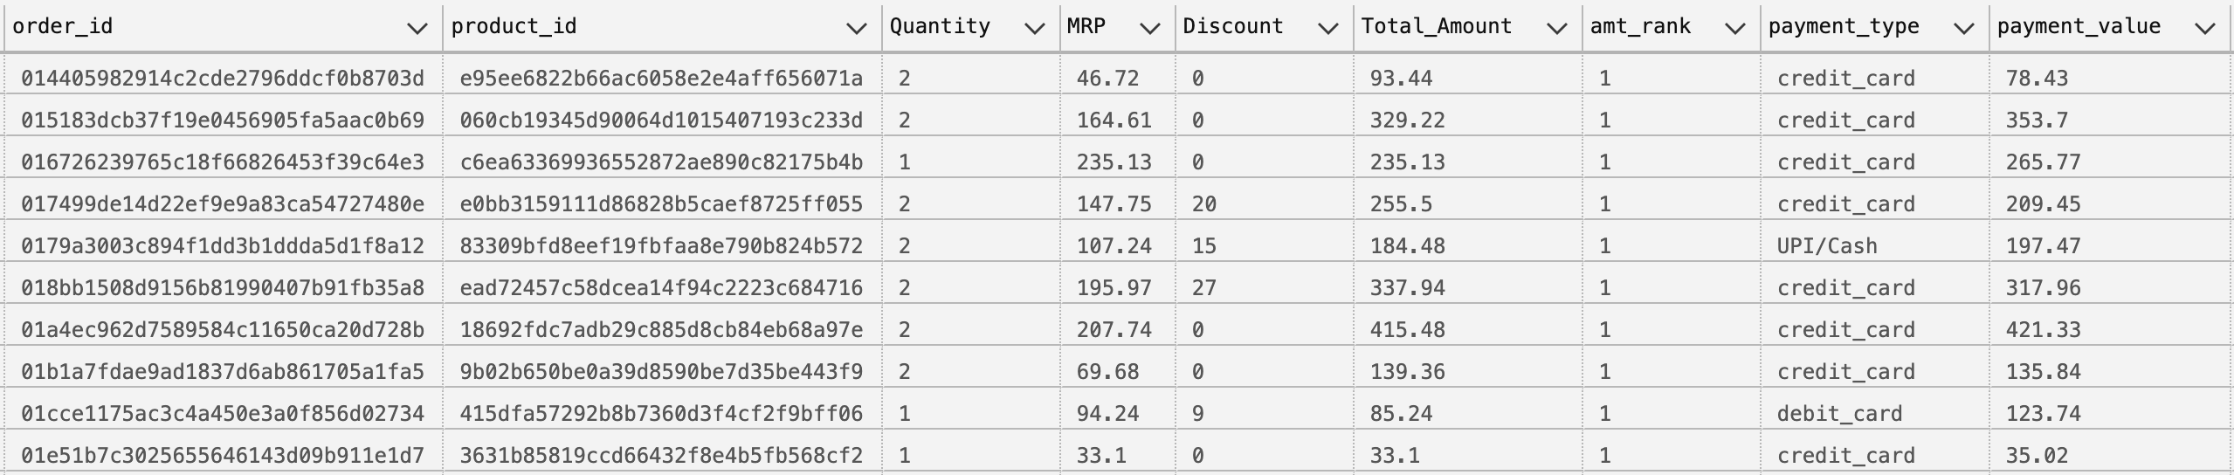
DATA DISCREPANCY (2/5)
The same order is delivered by different stores on different date , despite the channel being In-Store.
When the Orders and OrderPayments tables are joined, multiple records show a discrepancy between the Total Amount and the Payment Value.

Slide 20

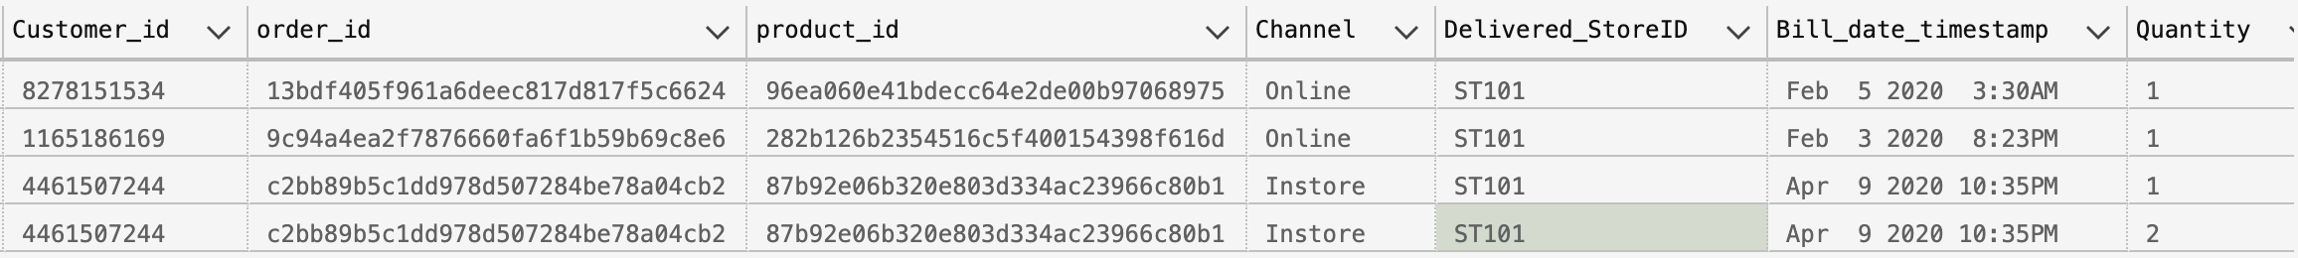
DATA DISCREPANCY (3/5)
Same order_id is associated to different customer_id.
There are 4 records associated with 3 distinct order_id that have dates falling outside the range of September 2021 to October 2023.

Slide 21
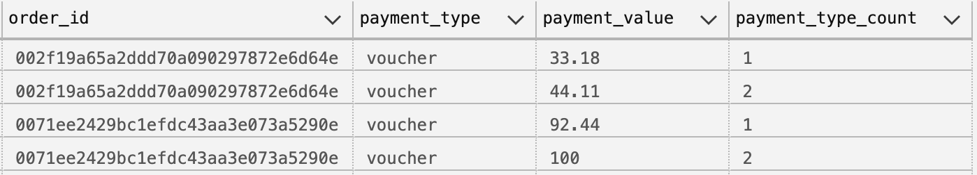
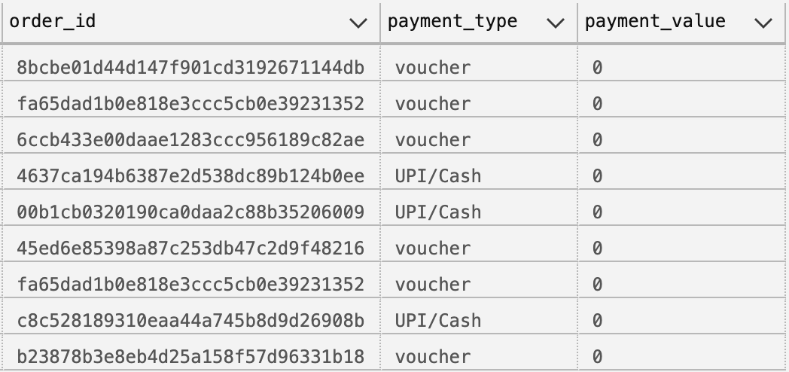
DATA DISCREPANCY (4/5)
IN ORDERS PAYMENT TABLE:
Multiple orders are fully paid using vouchers.
There are 9 records with a payment value of 0.

Slide 22

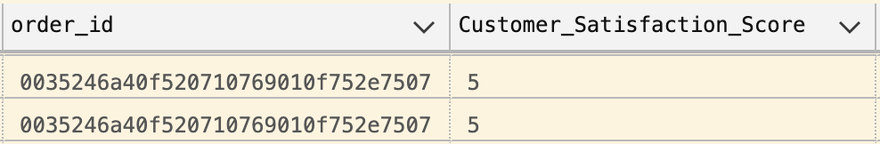
DATA DISCREPANCY (5/5)
Same order has been partially paid using the same payment method.
IN ORDERS REVIEW RATING TABLE:
Single order_id has multiple ratings.

Slide 23
DESCRIPTIVE ANALYSIS (1/6)
Answering: ”WHAT HAPPENED?"
This involves summarizing the data using statistics, KPIs, aggregations, and visualizations.
UNIVARIATE ANALYSIS
Variable | Analysis | Description
total_amount | Histogram, mean, median, outliers | Understand revenue distribution
quantity | Frequency plot, summary stats | Avg. number of items per order
MRP, discount, cost_per_unit | Boxplot, range | Price and discount distribution
channel | Count, % share | Channel popularity
payment_type | Bar plot | Preferred payment modes
customer_state, seller_state | Count | Regional spread
product_category | Count, frequency | Most common product types
customer_satisfaction_score | Average, trend | Customer feedback overview

Slide 24
DESCRIPTIVE ANALYSIS (2/6)
BIVARIATE & MULTIVARIATE ANALYSIS
Combination | Analysis | Purpose
discount vs total_amount | Scatter plot, correlation | Is discount boosting sales?
payment_value vs total_amount | Deviation flag | Underpayment or overpayment detection
MRP, discount, quantity, total_amount | Feature interaction matrix | Price sensitivity insights
bill_date_timestamp vs revenue | Time series plot | Monthly, weekly sales trend
customer_state vs seller_state | Heatmap | Cross-state transaction pattern
product_id vs MRP | Boxplot | MRP consistency for a product

Slide 25
DESCRIPTIVE ANALYSIS (3/6)
KEY PERFORMANCE INDICATORS (KPIs)
KPI | Calculation | Purpose
💰 Total Revenue | SUM(total_amount) | Measure overall performance
🛍️ Total Transactions | COUNT(DISTINCT order_id) | Volume of orders
👤 Unique Customers | COUNT(DISTINCT customer_id) | Customer base size
💳 Average Order Value (AOV) | SUM(total_amount) / COUNT(order_id) | Revenue per order
🧺 Average Basket Size | SUM(quantity) / COUNT(order_id) | Items per order
🔁 Repeat Customer Rate | COUNT(customers with >1 order) / COUNT(unique customers) | Loyalty indicator
📦 Top Products Sold | RANK() OVER (ORDER BY SUM(quantity)) | Inventory and marketing
📊 Channel Distribution | % of orders by channel | Channel usage analysis
📍 Store-wise Sales | Group by delivered_storeId | Regional performance
⏱️ Sales Over Time | Group by bill_date_timestamp | Trend & seasonality

Slide 26
DESCRIPTIVE ANALYSIS (4/6)
KEY RESULT AREAS (KRAs)
Functional performance metrics (sales, customer behavior, product movement).
KRA | Analysis | Metric
📦 Product Performance | Revenue, quantity sold, return rate per product | SUM(quantity), SUM(total_amount)
🧑‍💼 Customer Engagement | Frequency, recency, monetary value (RFM) | RFM Scores
📍 Store Operations | Store-wise revenue and orders | SUM(total_amount) BY store_id
💬 Customer Feedback | Avg. customer satisfaction score | AVG(customer_satisfaction_score)
📆 Sales Timing | Orders by hour, day, month | Distribution patterns
💸 Discount Efficiency | Revenue impact of discounts | Discount vs Revenue trend

Slide 27
DESCRIPTIVE ANALYSIS (5/6)
KEY RISK INDICATORS (KRIs)
Highlight potential threats or inefficiencies.
KRI | Metric/Indicator | Purpose
🛑 High Discount Dependency | High discount % = SUM(Discount)/SUM(Price) | Threat to profit margin
🚫 Frequent Product Returns | Return Rate > threshold | Product dissatisfaction
📉 Low Stock Turnover | Inventory / Sales (high value = low turnover) | Overstocking risk
💵 Unusual Payment Patterns | Spikes in specific payment method | Fraud detection
🧮 Sales Volatility | Standard deviation of daily/weekly sales | Unstable revenue stream
🕵️ Anomalous Transactions | Outliers in Total_Amount, Quantity, or Discount | Fraud or errors

Slide 28
DESCRIPTIVE ANALYSIS (6/6)
DESCRIPTIVE STATISTICS & VARIABLES
Variable | Analysis | Purpose
Total_Amount | Mean, median, min, max, std. dev | Price dispersion, revenue health
Quantity | Distribution, outliers | Buying pattern, bulk purchases
Bill_date_timestamp | Time series plot | Peak periods, seasonality
Store_id or Location | Geo clustering, bar plots | Regional performance
Customer_id | Frequency of transactions | Customer loyalty or churn
Category | Category analysis | Inventory decisions

Slide 29
DIAGNOSTIC ANALYSIS (1/6)
Answering: “WHY DID IT HAPPEN?”
It helps explain root causes of trends, changes, and anomalies observed in descriptive data.
KEY PERFORMANCE INDICATORS (KPIs)
KPIs show the outcomes we are trying to explain.
KPI | Diagnostic Extension | Purpose
🧾 Revenue Drop (%) | Compare to previous periods → identify time, location, product category, or customer segment causing drop | Understand source of revenue decline
🛍️ Basket Size Change | Segment by customer, category, store → find reason for drop in quantity per transaction | Identify changing customer behavior
💳 Change in Payment Method Share | Shift in method usage → look at payment failure, preferences | Discover friction in checkout
🛒 Product Demand Shift | Drop/increase in sales by product/category → seasonal factors, pricing | Inventory planning
📈 Change in Average Selling Price (ASP) | ASP = Revenue / Quantity → understand price sensitivity or discount effect | Track discount impact

Slide 30
DIAGNOSTIC ANALYSIS (2/6)
KEY RESULT AREAS (KRAs)
KRAs are functional areas where root cause analysis is needed.
KRA | Diagnostic Questions | Metrics/Variables
🧍‍♀️ Customer Engagement | Why is customer retention dropping? | Recency, Frequency, Spend, Satisfaction
📦 Product Performance | Why did a top product’s sales drop? | quantity, MRP, category, review score
🏪 Store Efficiency | Why are certain stores underperforming? | store_id, location, order volume, satisfaction
🧾 Invoice Trends | Why low/high orders during particular hours? | order_id, Bill_date_timestamp
🕒 Sales Timing | Why low sales during particular hours? | Bill_date_timestamp, total_amount, quantity

Slide 31
DIAGNOSTIC ANALYSIS (3/6)
KEY RISK INDICATORS (KRIs)
KRI | Diagnostic Measures | Root Cause Analysis
📉 Sudden Revenue Drop | Change-point detection in time series, split by store/product | Pinpoint exact drop source
❌ High Return Rate | Return Reason Analysis, Product/Customer-specific return ratios | Product defects, wrong sizing
🎯 Promotions Not Driving Sales | Campaign effectiveness = Lift in sales / Cost of promotion | Identify ineffective discounting
📉 Declining Customer Count | Time series of unique customer_id | Drop in new or repeat customers
🧾 Outlier Discounts | Z-score or IQR to find unusually high discounts → employee misuse or pricing errors | Reduce margin leakage

Slide 32
DIAGNOSTIC ANALYSIS (4/6)
IMPORTANT VARIABLES FOR DIAGNOSTIC ANALYSIS
Variable | Role
order_id, customer_id | Transaction/customer identification
channel, payment_type | Behavioral segment
MRP, discount, total_amount | Pricing logic validation
product_id, category | Sales trends and consistency
customer_state, seller_state | Regional mismatch detection
customer_satisfaction_score | Diagnostic proxy for quality
bill_date_timestamp | Date validity and trend analysis

Slide 33
DIAGNOSTIC ANALYSIS (5/6)
DIAGNOSTIC ANALYSIS TECHNIQUES
Technique | Purpose | Example
📊 Time-over-Time Comparison | Compare same metric across periods | Revenue drop from Jan to Feb
🪜 Drill-Down Analysis | Break metrics by subcategories | Revenue ↓ → store-wise → product-wise
🔎 Outlier Detection | Spot abnormal patterns | Quantity > 1000
🔄 Before vs After Comparison | Assess impact of changes | Before/after promotion or new pricing
🔬 Correlation Analysis | Find relationships between variables | Discount ↑ vs sales ↑?
📚 Classification Tree | Root cause of low satisfaction | Which variables explain satisfaction < 3?
📈 Trend Decomposition | Split into trend, seasonality, noise | Sales fluctuations over time

Slide 34
DIAGNOSTIC ANALYSIS (6/6)
SAMPLE DIAGNOSTIC QUESTIONS & ANALYSIS
Question | Metric Involved | Diagnostic Insight
Why did sales drop last month? | total_amount, order_id, store_id, product_id | Store X had inventory issue, Product Y sales dropped
Why is Avg Basket Size low in Region A? | quantity, channel, product_category | Low upselling or seasonal product unavailability
Why is Store B underperforming? | order volume, satisfaction, discount | High complaints, few repeat customers
Why is discount not increasing sales? | discount, quantity | High discount on non-popular products
Why are there zero payment orders? | payment_value, order_id | System issue or fraud flag

Slide 35
PREDICTIVE ANALYSIS
GOAL: Anticipate future outcomes using historical data.
PREDICTIVE KPIs & MODELS:
Prediction Target | Model Type | Input Variables | Use Case
📈 Sales Forecast | Time Series (ARIMA, Prophet, LSTM) | bill_date_timestamp, total_amount | Inventory & revenue planning
💳 Customer Churn | Classification (Logistic, XGBoost) | RFM, channel, recency, satisfaction | Targeted retention campaigns
🧾 Product Demand | Regression | Product category, time, promotion, past sales | Inventory & procurement
🧺 Basket Prediction | Recommendation Engine (Apriori, ML models) | customer_id, product_id, frequency | Cross-selling & personalization
📊 Satisfaction Score Prediction | Regression or classification | Product, store, payment, delivery time | Quality & service alerts
💰 Discount Sensitivity | Price Elasticity (regression) | MRP, discount %, quantity sold | Dynamic pricing decisions

Slide 36
PRESCRIPTIVE ANALYSIS
GOAL: Suggest the best possible decision based on predicted outcomes and business constraints.
PRESCRIPTIVE KPIs & TECHNIQUES:
Use Case | Optimization Method | Output
📦 Inventory Allocation | Linear programming | Units per store per SKU
💸 Discount Optimization | What-if analysis, price elasticity model | Best discount % per product
🧑‍🤝‍🧑 Customer Targeting for Promotion | Uplift modeling | Target list with expected ROI
⏰ Staff Scheduling | Constraint optimization | Staff per store per time slot
🚚 Delivery Route Optimization | TSP or Reinforcement Learning | Fastest/cheapest delivery plan

Slide 37
COGNITIVE ANALYSIS
GOAL: Use AI and human-like reasoning (NLP, vision, voice) to extract insights from unstructured data.
COGNITIVE USE CASES:
Data Type | Technique | Insight
📝 Customer Reviews | NLP Sentiment Analysis | Detect product issues, service feedback
🧾 Support Tickets | Topic Modeling (LDA, BERT) | Common complaint categories
📷 Product Images | Computer Vision (CNN) | Identify defects, tag attributes
🧠 Chatbot Logs | Intent Recognition (NLP) | Automate customer service
🗣️ Voice/Call Analysis | Speech-to-Text + Sentiment | Quality assurance for call centers

Slide 38
REAL-TIME ANALYSIS
GOAL: Monitor and respond to events immediately.
REAL-TIME KPIs & SYTEMS:
KPI | Source | Use
⚠️ Fraud Detection Score | Streaming payment data | Block suspicious transactions
🛍️ Live Orders per Minute | Transaction stream | Capacity planning
📉 Stock Alerts | Inventory sensor feed | Trigger reorder/restock
⏳ Wait Time Estimation | POS system logs | Dynamic staff allocation
🚀 Real-Time Recommendations | Browsing/clickstream | Improve conversions

Slide 39
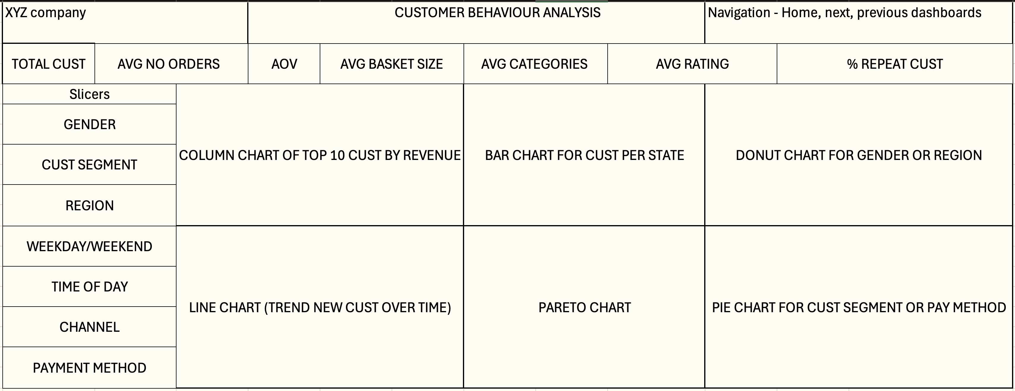
DASHBOARD (1/12)
CUSTOMER BEHAVIOUR ANALYSIS:

Slide 40
DASHBOARD (2/12)
STAKEHOLDERS FOR THE CUSTOMER BEHAVIOUR ANALYSIS DASHBOARD:
Marketing Team
Understand customer demographics and behavior.
Target campaigns based on repeat customers and segment trends.
Customer Relationship Management (CRM) Team
Focus on customer retention, loyalty, and satisfaction.
Identify and reward high-value customers.
Sales Team
Monitor customer purchase behavior and potential upselling opportunities.
Product Team
Identify which customer segments prefer which categories and basket sizes.
Improve product bundling strategies.
CX (Customer Experience) Team
Track average ratings, understand pain points and improve experience.
Finance/Strategy Team
Estimate Customer Lifetime Value (CLV).
Evaluate acquisition vs retention cost tradeoffs.

Slide 41
DASHBOARD (3/12)
📊 Key Insights From Customer Behaviour Analysis Dashboard:
Dashboard Element | Insights
KPIs (Total Cust, AOV, % Repeat Cust, etc.) | Snapshot of customer metrics: revenue per user, loyalty rate, satisfaction (ratings), engagement (basket size, categories)
Column Chart (Top 10 Customers by Revenue) | Identify most valuable customers for loyalty rewards or upsell focus.
Bar Chart (Cust per State) | Discover geographic distribution of customers.
Donut Chart (Gender or Region) | Determine gender or region-wise customer base.
Line Chart (New Customer Trend) | Analyze customer acquisition over time—see the effect of campaigns, launches.
Pareto Chart | 80/20 analysis—find if a small % of customers are driving most revenue.
Pie Chart (Cust Segment / Payment Method) | Understand segment preferences and popular payment modes.

Slide 42
DASHBOARD (4/12)
💡 Strategic Suggestions & Recommended Actions From Customer Behaviour Analysis Dashboard:
Action Area | Suggested Action
Customer Retention | Focus on increasing % Repeat Customers with loyalty programs, win-back campaigns.
Targeted Campaigns | Use slicers like Gender, Region, Cust Segment to create segment-specific offers.
Top Customers | Use the Top 10 Revenue Customers chart to design exclusive VIP perks or personalized recommendations.
Payment Preferences | Promote or simplify most used payment methods; troubleshoot unpopular ones.
Category Expansion | If avg categories per customer is low, promote cross-category offers/bundles.
Improve UX/Service | If ratings are low but basket size is high, there might be post-purchase service gaps.
Time-based Campaigns | Use day/time and weekday/weekend slicers to schedule campaigns during high-conversion windows.
Customer Acquisition Strategy | Optimize ad spends during periods with low new customer acquisition (from Line Chart).

Slide 43
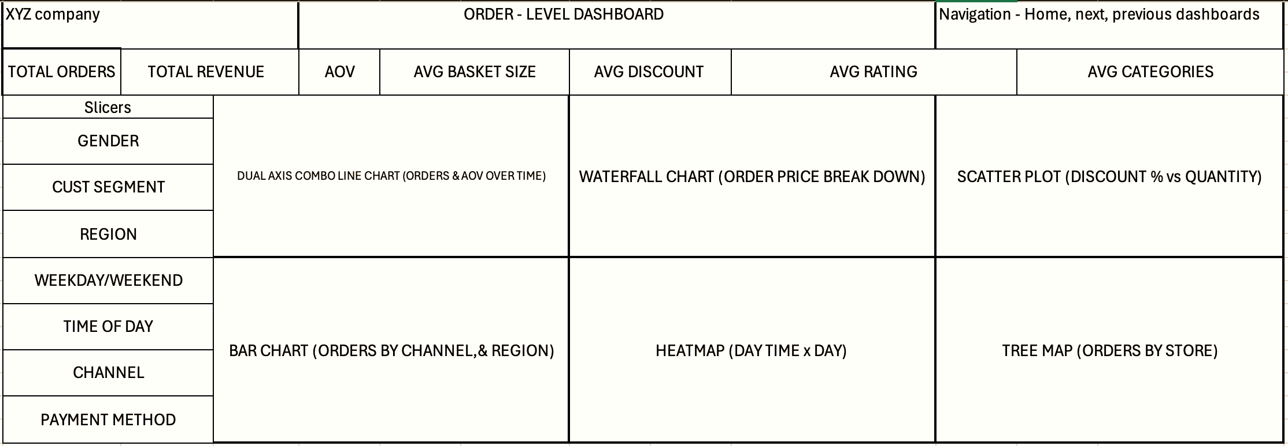
DASHBOARD (5/12)
ORDER-LEVEL ANALYSIS:

Slide 44
DASHBOARD (6/12)
Stakeholders for the Order-Level Dashboard:
Sales Team
To monitor order volumes, revenue, and discounts.
Understand which channels or regions are performing well.
Marketing Team
To analyze impact of discounts and promotions.
Identify high-value customer segments for targeted campaigns.
Operations/Logistics
To ensure resource allocation based on order volumes by time, region, or day.
Optimize delivery routes and warehouse operations.
Customer Experience (CX) Team
Use ratings and basket size to understand satisfaction.
Improve post-purchase experience based on order trends.
Finance Team
To track revenue, average order value (AOV), and price breakdowns.
Monitor cost-impact of discounts and payment method usage.
Store Managers / Regional Heads
For performance comparison of stores/regions (via Tree Map and Bar Charts).
Make staffing or inventory decisions.

Slide 45
DASHBOARD (7/12)
📊 Key Insights from Order-Level Dashboard:
Dashboard Element | Insights
KPIs | Identify overall performance via metrics like Total Orders, Revenue, AOV, etc.
Dual Axis Line Chart | Spot trends in order volume vs AOV over time (e.g., seasonal spikes, declining average order size).
Waterfall Chart | Breakdown of order price—helpful for analyzing contribution of base price, taxes, shipping, discounts.
Scatter Plot | Correlation between discount percentage and quantity purchased—find discount sweet spots.
Bar Chart | Orders by channel & region—determine best performing sales channels and regions.
Heatmap | Peak shopping times—optimize staffing, marketing push, and server/inventory readiness.
Tree Map | Store performance—identify high/low performing stores for intervention or incentives.

Slide 46
DASHBOARD (8/12)
💡 Strategic Suggestions & Recommended Actions from Order-Level Dashboard:
Action Area | Suggested Action
Optimize Marketing Offers | If high discounts don’t yield more quantity (from scatter plot), revise strategy.
Customer Segmentation | Tailor marketing based on Customer Segment + Region slicers.
Channel Investment | Boost underperforming but high-potential channels using insights from channel-based order volumes.
Improve Checkout UX | If payment method slicer shows strong preference for one method, consider simplifying or promoting it.
Staff Planning | Use heatmap to increase staff/logistics support during peak hours/days.
Rating-Driven Actions | If Avg Rating is low despite high AOV, investigate post-sale service.
Basket Size Strategy | Use bundle offers if Avg Basket Size is low despite high AOV.
Revenue Forecasting | Use the dual-line chart and KPIs for trend-based revenue forecasting.

Slide 47
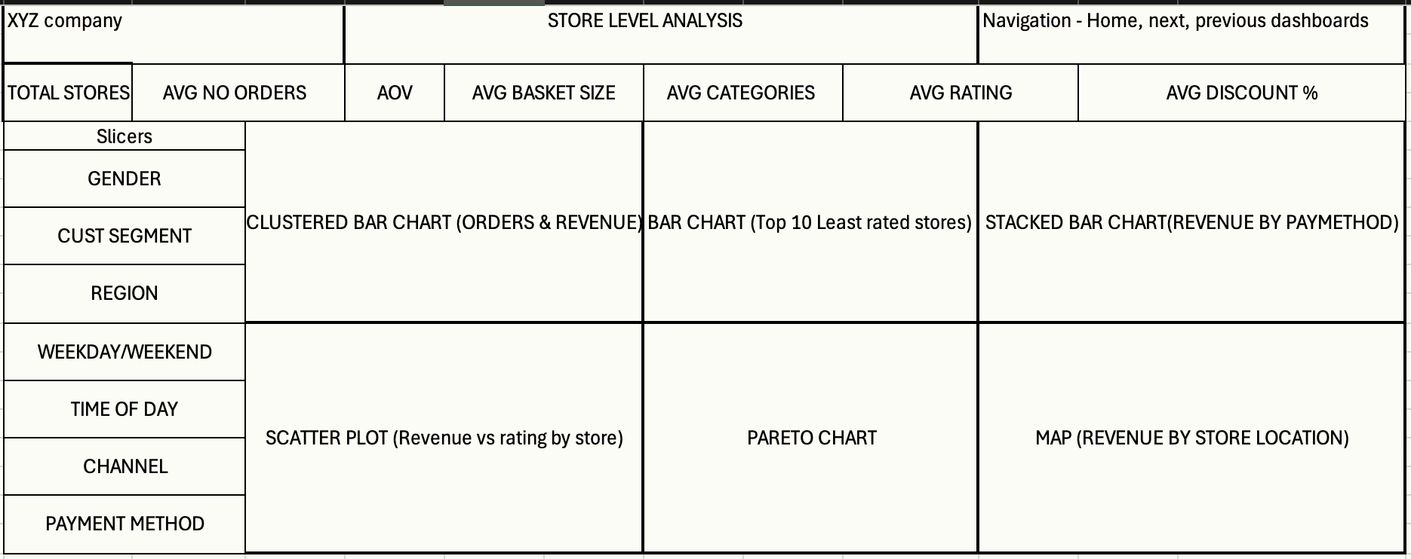
DASHBOARD (9/12)
STORE-LEVEL ANALYSIS:

Slide 48
DASHBOARD (10/12)
STAKEHOLDERS FOR THE STORE-LEVEL DASHBOARD:
Regional & Store Managers
Monitor store performance by orders, revenue, rating, and basket size.
Take location-specific actions to boost underperforming stores.
Operations Team
Analyze patterns in store traffic and payment methods to streamline in-store operations and logistics.
Finance Team
Track store-level revenue performance and evaluate discount strategies.
Marketing Team
Target store-specific campaigns based on customer behavior and performance insights.
Customer Experience (CX) Team
Use rating insights to improve service quality at poorly rated locations.
Strategy & Leadership
Evaluate expansion or consolidation decisions using store-wise profitability and customer metrics.

Slide 49
DASHBOARD (11/12)
📊 Key Insights from Store-Level Dashboard:
Dashboard Element | Insights
KPIs (Total Stores, AOV, Ratings, Avg Discount %, etc.) | Quick summary of performance across stores—identify trends, performance gaps.
Clustered Bar Chart (Orders & Revenue) | See which stores generate high orders vs high revenue—identify high-value vs high-traffic stores.
Bar Chart (Top 10 Least Rated Stores) | Pinpoint customer dissatisfaction hotspots for urgent CX improvements.
Stacked Bar Chart (Revenue by Payment Method) | Understand payment method preferences store-wise to optimize POS setups.
Scatter Plot (Revenue vs Rating) | Correlation between customer satisfaction and revenue—identify stores that earn well but deliver poor experiences.
Pareto Chart | Apply 80/20 rule—see if 20% of stores bring 80% of the revenue.
Map (Revenue by Store Location) | Geospatial distribution of revenue—plan for expansion or redistribution of resources accordingly.

Slide 50
DASHBOARD (12/12)
💡 Strategic Suggestions & Recommended Actions From Store-Level Dashboard:
Action Area | Suggested Action
Store Performance Optimization | Use clustered bar chart to identify stores that need sales improvement or staff realignment.
Ratings Improvement | Focus on low-rated stores for training, customer service quality programs.
Location-Based Strategy | Map visualization can help decide where to open/close stores or expand marketing.
Discount Effectiveness | Evaluate whether stores offering high discounts are getting ROI (via AOV, discount %, rating).
Payment Setup Improvements | Modify or promote store-specific payment methods based on revenue breakdown.
Time-Based Campaigns | Use slicers like Time of Day, Weekday/Weekend to optimize operations for footfall.
Customer Behavior Adaptation | Adapt in-store strategies based on customer segment, gender, and region filters.
Store Performance Optimization | Use clustered bar chart to identify stores that need sales improvement or staff realignment.

Slide 51
HIGH-LEVEL METRICS
ORDERS
Total Orders | 96,899
Total Quantity | 108.83 k
Total Products | 31.75 k
Total Categories | 14
Total Payment Methods | 4
Total Revenue | ₹15.45 M
Total Cost | ₹13.27 M
Total Profit | ₹2.18 M
Total Discount | ₹538.89 k
Profit Percentage | 14.13%
Discount Percentage | 3.18%
Average Order Value | ₹159.46
Average Profit | ₹22.54
Average Discount | ₹5.56
Average Category | 1.004
Average Rating | 4.1
Average Number of Days Between Two Orders | 6.07

Slide 52
HIGH-LEVEL METRICS
CUSTOMERS
STORES
Total Customers | 96,808
Total Customers Cities | 4,092
Average Sales | ₹162.54
Average Profit | ₹22.99
Average Discount | ₹5.67
Average Transactions | 1.001
Total Repeating Customers | 36
Repeat Customer Rate | 0.04%
One Time Buyers | 99.96%
Total Stores | 37
Total States Stores Located | 7
Average Revenue | ₹417.59 k
Average Quantity | 2.94 k
Average Total Profit | ₹59.02 k
Average Total Discount | ₹13.29 k
Average Number of Orders | 2.65 k
Average Rating | 3.84
Average Categories | 13
Average Customer Visits | 2.65 k
Average Number Of Products | 889

Slide 53
EXPLORATORY DATA ANALYSIS

Slide 54
EXPLORATORY DATA ANALYSIS

Slide 55
OBSERVATIONS & RECOMMENDATIONS
🔍 Observations:
Customer Acquisition Trend
Strong growth from Jan 2022 to mid-2023, peaking at 7.68k in Aug 2023.
Sudden drop to 0.07k in Sep 2023 indicates a potential data or operational issue.
Revenue Insights
70% of revenue is contributed by female customers.
High Revenue customers account for the largest segment (34%).
Customer Revenue Source
New customer revenue peaked early, then plateaued, while existing customer revenue surged in 2023.
Suggests strong loyalty or retention among existing users.
Channel Performance
In-store channel dominates with 88% of total revenue (₹13.54M).
Online channel underperforms at just 2% (₹0.28M).
✅ Recommendations:
Investigate Drop in Customer Acquisition (Sep 2023)
Review marketing efforts, data pipelines, or customer onboarding issues.
Leverage High-Value Female Segment
Tailor campaigns and loyalty programs for female customers.
Boost Online Presence
Invest in digital marketing and improve online UX to increase revenue share.
Strengthen Retention Programs
Given growing revenue from existing users, enhance loyalty rewards & engagement strategies.
Explore Upselling Opportunities in Medium/Low Revenue Segments
Use targeted promotions to shift them into the high-revenue category.

Slide 56
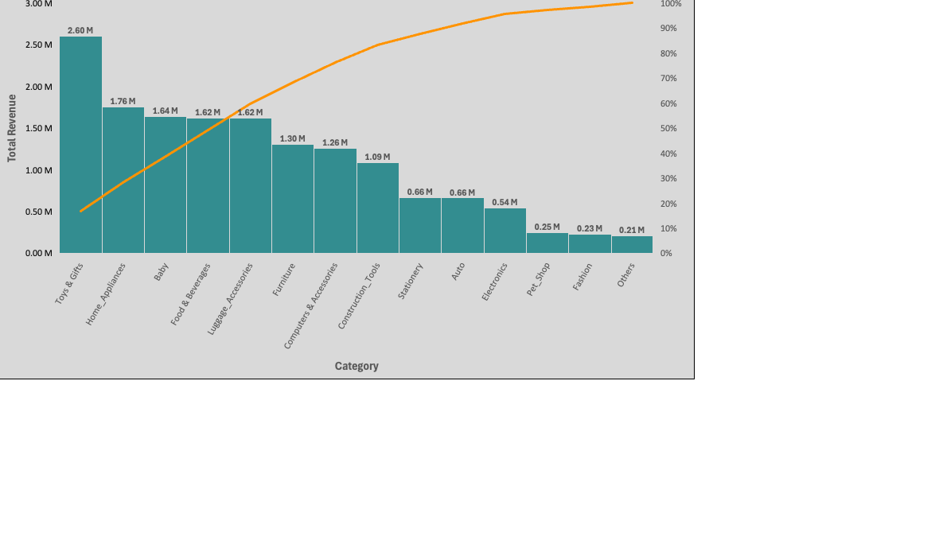
EXPLORATORY DATA ANALYSIS

Slide 57
EXPLORATORY DATA ANALYSIS

Slide 58
OBSERVATIONS & RECOMMENDATIONS
🔍 Key Observations:
Category Revenue Concentration (Pareto Analysis):
Top 5 categories (Toys & Gifts, Home Appliances, Baby, Food & Beverages, Luggage) contribute to ~70%of total revenue.
Long tail of categories contributes marginally.
Payment Method Distribution:
Credit Cards dominate (75%), followed by UPI/Cash (20%).
Very limited usage of Debit Cards (4%) and Vouchers (1%).
Regional Performance:
South Region leads with 72% revenue, while East contributes only 2%.
Top Products by State:
Gujarat, Andhra Pradesh, and West Bengal show strong product-level revenue.
Variability in product performance across states suggests regional preferences.
✅ Recommendations:
Focus on High-Performing Categories: Invest in marketing, stock, and promotions for the top 5 revenue-generating categories.
Expand Regional Penetration: Explore opportunities to grow in East & West regions through localized promotions and partnerships.
Optimize Payment Options: Encourage UPI adoption further and explore loyalty schemes for debit/voucherusers to balance mode dependency.
Personalize by Region: Curate state-specific product bundles based on bestsellers in each region for better targeting.
Rationalize Long Tail Categories: Evaluate and possibly phase out underperforming categories to streamline offerings.

Slide 59
RATING ANALYSIS

Slide 60
OBSERVATIONS & RECOMMENDATIONS
🔍 Key Observations:
📦 Category Rating
Pet Shop (4.22) has the highest customer satisfaction.
Others (3.89) and Furniture (3.93) are the lowest-rated categories.
Popular categories like Toys & Gifts, Food & Beverages, and Luggage maintain high ratings (~4.13–4.16).
🧾 Seller State Rating
West Bengal (4.16) and Chhattisgarh (4.15) lead in seller experience.
Gujarat (3.98) is the lowest-rated seller state.
🏪 Store Rating
Top-performing stores (e.g., ST380, ST301, ST106) have ratings above 4.22.
ST143 and ST161 have the lowest ratings (3.76, 3.90) — areas of concern.
🌍 Region Rating
East (4.16) has the highest regional satisfaction.
West (3.98) is the only region below 4.0, indicating lower customer experience.
✅ Recommendations:
🔧 Improve Low-Rated Categories:
Audit and enhance product quality and post-purchase experience for Furniture, Baby, and Others.
📍 Target Low-Rated Regions:
Focus on operational improvement and customer support in West region and Gujarat.
Deploy feedback surveys and quality checks in low-rated stores (e.g., ST143, ST161).
📈 Replicate High Performers:
Study best practices of top-rated Pet Shop category, ST380, and East region — replicate across others.
🎯 Incentivize Ratings:
Encourage customer feedback post-purchase with reward points or coupons to increase transparency and improvement.

Slide 61
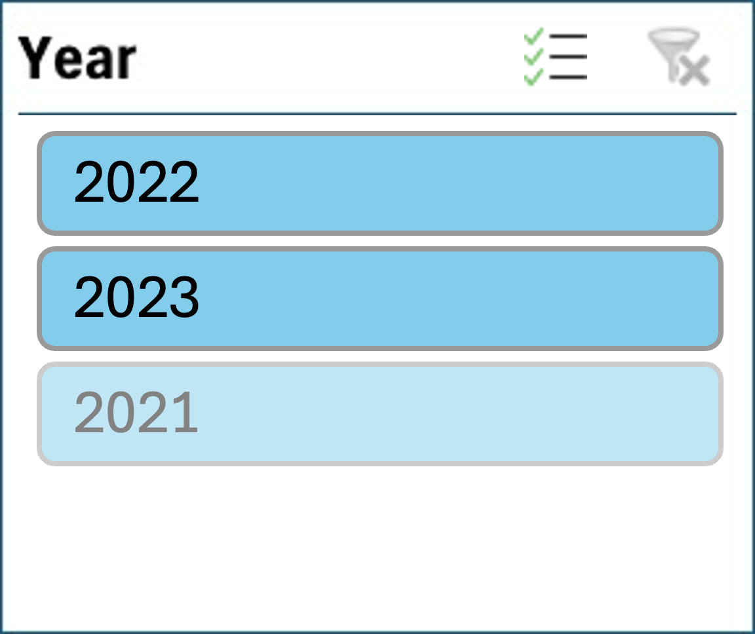
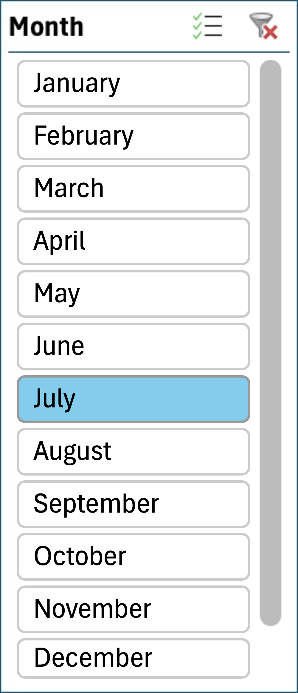
CATEGORY PENETRATION

Slide 62
CATEGORY ANALYSIS

Slide 63
CATERGORY ANALYSIS

Slide 64
OBSERVATIONS & RECOMMENDATIONS
🔍 Observations:
Category Penetration (July 2023):
Toys & Gifts (16%), Home Appliances (13%), and Food & Beverages (12%) have the highest customer reach.
Electronics, Pet Shop, Fashion, Others are under-penetrated (<4%).
Revenue vs Contribution (Top Categories per Store):
Toys & Gifts and Baby categories dominate both revenue and % contribution across multiple stores.
Some stores have over 70% revenue dependence on a single category, indicating risk.
Regional Category Trends:
North: Balanced demand across multiple categories (Top: Luggage & Home Appliances).
South: Toys & Gifts (18%) leads, followed by Food & Home.
West: Baby (38%) is highly dominant.
East: Home Appliances (29%) and Computers (23%) are key performers.
✅ Recommendations:
📌 Boost Low Penetration Categories: Target segments like Electronics, Pet Shop, Fashion with promotions & bundling to increase market reach.
🛍️ Diversify Category Portfolio: Reduce over-reliance on a single category per store to mitigate concentration risk.
🌍 Region-Based Strategy:
West: Expand categories beyond Baby to balance mix.
East: Capitalize on strong tech/home category demand.
South/North: Test new bundles in already diverse category landscapes.
🎯 Tailored Campaigns: Run personalized regional offers based on top-selling local categories for better engagement and ROI.

Slide 65
CATEGORY ANALYSIS

Slide 66
CATEGORY ANALYSIS

Slide 67
OBSERVATIONS & RECOMMENDATIONS
🔍 Key Observations:
Toys & Gifts consistently leads in revenue across most regions and seller states (South, Andhra Pradesh) with up to ₹2.05M revenue and 18% contribution.
Regional dominance varies:
In the South, multiple categories generate high revenue (Food & Beverages, Home Appliances).
North and West show lower absolute revenues, but categories like Baby and Computers & Accessories achieve high percentage contributions (38% in North, 29% in East).
High % contributions are driven by niche categories, not necessarily by high revenue (e.g., Baby in North, Computers & Accessories in East).
Fragmentation in East & minor states: Revenue is low and spread thin across more categories, but certain categories have steep % contributions, suggesting limited competition.
State-wise, Andhra Pradesh outperforms on both absolute revenue and diversity of top-performing categories..
✅ Recommendations:
Double down on leading categories like Toys & Gifts and Food & Beverages in high-revenue regions (South, Andhra Pradesh) through focused marketing and inventory optimization.
Expand presence in under-penetrated categories with high % contributions but low revenue—examples: Baby in North and Computers & Accessories in East and West Bengal.
Tailor regional category strategies:
Scale proven categories in top states/regions, but pilot niche category campaigns in regions with high relative % contribution.
Leverage cross-selling in fragmented and low-competition regions/states (East, Madhya Pradesh) to build category presence and increase absolute revenue.
Monitor trends in % contribution to proactively identify and promote upcoming niche categories before competitors.

Slide 68
DISCOUNT VS NON-DISCOUNT SEEKER ANALYSIS
Flag | Discount Seeker | Non-Discount Seeker
Total Customer | 39,068 | 57,740
Total Revenue | ₹6.48 M | ₹9.25 M
Average Order Value | ₹165.99 | ₹160.18
Average Discount | ₹14.04 | ₹0.007
Average Profit | ₹27.86 | ₹19.70
Average Basket Size | 1.14 | 1.15
Average Categories | 1.018 | 1.004
Average Products | 1.020 | 1.008

Slide 69
DISCOUNT VS NON-DISCOUNT SEEKER ANALYSIS

Slide 70
OBSERVATIONS & RECOMMENDATIONS
🔍 Key Observations:
Revenue Trend:
Non-Discount Seekers consistently contribute more revenue than Discount Seekers across all months.
Both segments show a decline in Sept 2023 — likely due to data lag or seasonality.
Customer Profile:
60% are Non-Discount Seekers; they generate 59% of total revenue.
Discount Seekers, despite receiving discounts, yield higher average profit per order (₹27.86 vs ₹19.70).
Behavioral Insights:
East is the only region where Discount Seekers contribute more revenue.
Average ratings are high overall, slightly better for Non-Discount Seekers (4.12 vs 4.07).
Order & Basket Metrics:
Discount Seekers show slightly lower basket size but higher category/product interaction.
✅ Recommendations:
💸 Maximize Profit via Discount Seekers:
Run targeted discount offers to encourage more high-profit conversions.
Expand this strategy in East region, where this group already dominates.
🧠 Leverage Non-Discount Seekers:
Launch premium, value-driven campaigns without discounts — ideal for this cost-tolerant segment.
Promote membership or subscription-based models.
🔄 Monitor Revenue Drop in Sep 2023:
Validate if it’s a seasonal dip or data inconsistency and adjust reporting cadence accordingly.
🎯 Balanced Strategy:
Avoid over-reliance on either segment.
Use behavioral clustering for personalized targeting — loyalty programs for NS, flash sales for DS.

Slide 71
CUSTOMER SEGMENT ANALYSIS
Segment | Premium | Gold | Silver | Standard
Total Customer | 15,050 | 33,548 | 41,927 | 6,283
Total Revenue | ₹0.97 M | ₹3.99 M | ₹8.85 M | ₹1.92 M
Avg Order Value | ₹64.71 | ₹118.95 | ₹211.13 | ₹305.15
Avg Discount | ₹2.81 | ₹4.49 | ₹7.08 | ₹9.39
Avg Profit | ₹15.83 | ₹19.49 | ₹26.68 | ₹34.19
Avg Basket Size | 1.052 | 1.105 | 1.191 | 1.284
Avg Categories | 1.001 | 1.003 | 1.007 | 1.023
Avg Products | 1.003 | 1.007 | 1.017 | 1.044

Slide 72
CUSTOMER SEGMENT ANALYSIS

Slide 73
OBSERVATIONS & RECOMMENDATIONS
🔍 Key Observations:
Silver Segment:
Largest contributor to total revenue (56%) and customer base (43%).
Steady growth trend with peak in mid-2023.
Moderate AOV (₹211), high basket size and engagement across products & categories.
Standard Segment:
Highest AOV (₹305) and profit per customer (₹34.19) despite being the smallest customer base (6%).
Low rating (4.08) and declining trend after mid-2023.
Gold Segment:
Stable contributor (12% revenue, 35% customers), moderate growth.
Consistent rating (4.15), second-highest satisfaction.
Premium Segment:
Smallest revenue and AOV but highest average rating (4.15).
Steady but low-performing in terms of volume.
✅ Recommendations:
🥈 Boost Silver Engagement: Launch loyalty tiers or exclusive perks — this segment drives the majority of value.
💰 Expand Standard Segment: Explore strategies to acquire more high-value Standard customers — profitable despite low volume.
📈 Upsell to Gold Members: Encourage Gold customers to try higher-ticket products to increase AOV.
🎯 Reposition Premium Segment: Refocus marketing to premium customers to justify pricing and increase conversions.
🌍 Target East & North Regions: Both show 59% of revenue from Silver, prime targets for scaling efforts.

Slide 74
TREND & SEASONALITY ANALYSIS

Slide 75
TREND & SEASONALITY ANALYSIS

Slide 76
OBSERVATIONS & RECOMMENDATIONS
📈 Revenue Trend Over Time
🔍 Observations:
Consistent upward trend from 2021 to mid-2023.
Peak revenue reached in Aug 2023 (₹1.23M).
Sudden sharp drop in Sep 2023 (₹0.02M), likely due to incomplete data or operational dip.
✅ Recommendations:
Investigate root cause of Sep 2023 drop.
Leverage upward momentum with forecast-driven promotions during peak periods.
⏰ Revenue by Time of Day
🔍 Observations:
Afternoon (23%) and Evening (21%) drive the highest revenue.
Morning (6%) shows lowest engagement.
✅ Recommendations:
Launch campaigns or flash sales in mornings to boost low-traffic hours.
Prioritize Afternoon/Evening slots for high-value promotions.
📅 Revenue by Day of Week
🔍 Observations:
Wednesday (27%) is the strongest revenue day.
Friday & Saturday contribute almost nothing to overall revenue.
✅ Recommendations:
Focus ads, emails, and offers midweek (especially Wednesday).
Re-engage customers with weekend-exclusive bundles or loyalty rewards.

Slide 77
CHALLENGES & LEARNINGS
CHALLENGES FACED:
🚧 Challenge | 🔍 Description
Data Quality Issues | Encountered missing values, duplicate orders, MRP inconsistencies, and incorrect total_amount calculations. Required custom data validation logic.
Encoding & Import Errors | UTF-8 character encoding errors while importing CSVs into MySQL and Power BI — required pre-processing and format conversion.
Complex Relationships | Handling foreign key relationships across multiple tables (Customers, Orders, Products, Payments, Stores) made modeling non-trivial.
Discrepancy Detection | Manual creation of validation flags (e.g. underpaid orders, cross-state in-store orders) to uncover hidden data issues.
Large Volume & Joins | Query performance dropped when working with large joins and aggregations; required indexing and filtering.
Designing Meaningful Visuals | Choosing the right chart type for RFM, customer engagement, and satisfaction required careful planning to avoid clutter.

Slide 78
CHALLENGES & LEARNINGS
KEY LEARNINGS:
📚 Learning | 💡 Insight
Importance of Data Cleaning | Data validation and cleaning are essential before any analysis — especially with transactional datasets.
Diagnostic Thinking | Going beyond KPIs to explore “Why” behind trends helped identify root causes and improve data quality.
Visual Storytelling in Power BI | Learned how to create interactive dashboards with slicers, cards, drill-downs, and what-if parameters.
Customer Behavior Modeling | Implemented RFM analysis, repeat rate, and basket size to profile customers effectively.
Real-World Retail Use Cases | Understood real business challenges like partial payments, product performance variance, and store-level KPIs.
Data Relationships Matter | Strong ER design and maintaining referential integrity across tables makes analysis robust and scalable.

Slide 79
THANK YOU!
For your attention

